Slide 1
Atomic Force Microscopy (AFM)
ECE658 Discussion Presentation
Name: Yi-Fan Wang
Professor: Peide Ye
Date: 04/06/26

Slide 2
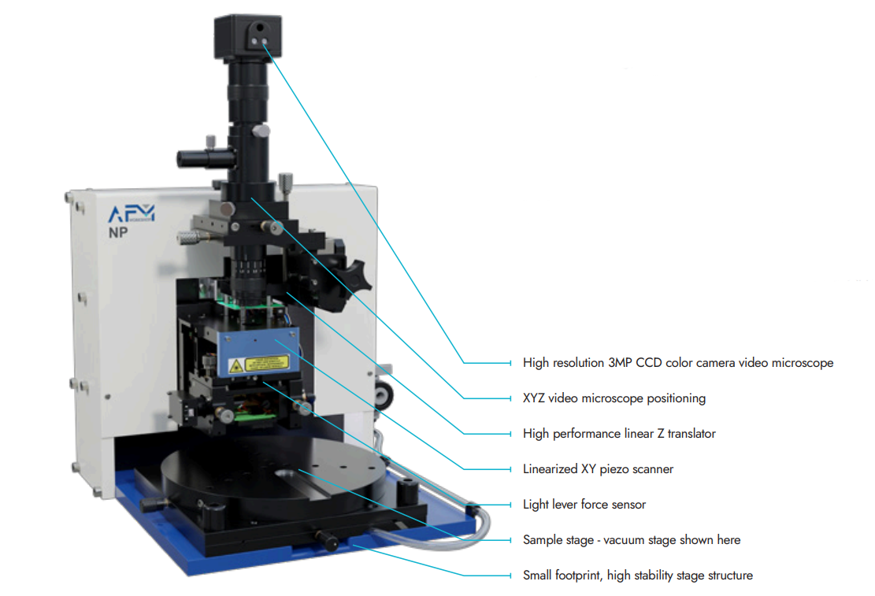
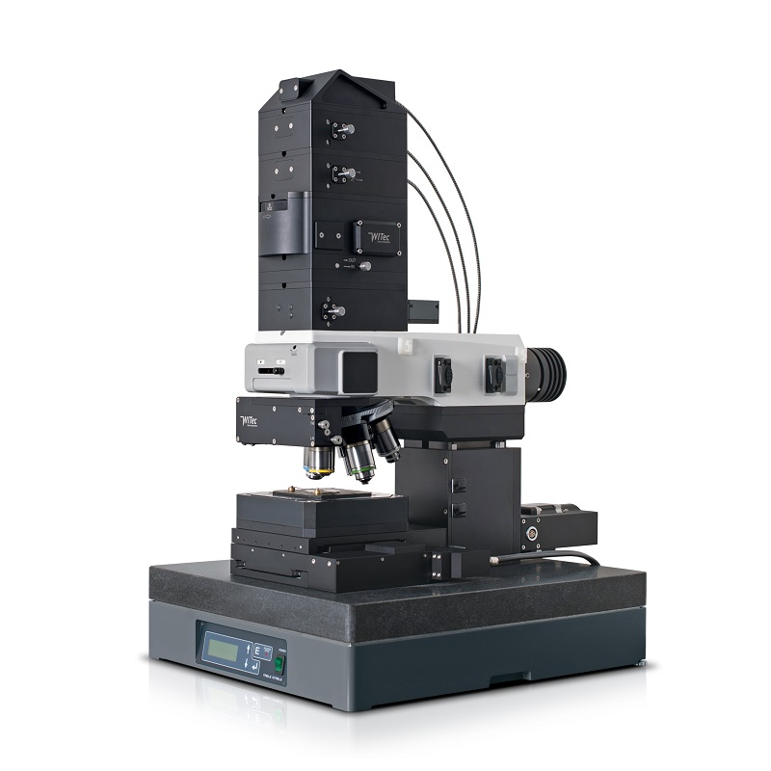
Introduction
Nanoscale surface characterization tool
Used to observe and measure the surface topography of the materials
3D surface profile and works in air/liquid
Can measure both conductive and insulating materials
Notes:
Atomic Force Microscopy, or AFM, is a technique used to observe and measure the surface topography of materials at the nanoscale.
One key advantage of AFM is that it provides a true three-dimensional surface profile, unlike many other microscopy techniques.
It can operate in different environments, including air and liquid, which makes it suitable for a wide range of applications, especially in biology and soft materials like human cells.
Another important advantage is that AFM can measure both conductive and insulating materials, which overcomes a major limitation of techniques like scanning tunneling microscopy.
Because of these capabilities, AFM is widely used in fields such as semiconductor characterization, nanotechnology, and biomaterials research.

Slide 3
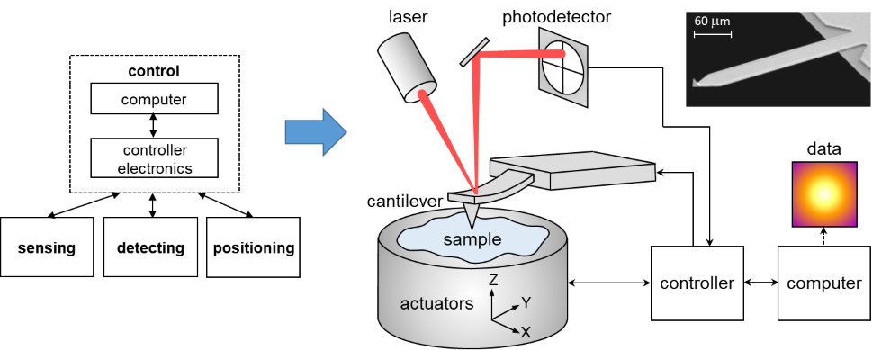
Working Principle of AFM
Force-based sensing with optical deflection detection
Sensing (Cantilever & Tip)
Detecting (Laser & photodetector)
Positioning (Piezoelectric actuator)
Notes:
This slide shows the key components of AFM and how they work together. The key idea is that AFM converts very small forces between the tip and the surface into a measurable 3D topography
tip & sample
The AFM sensor is a cantilever with a very sharp tip at its free end, typically with a radius on the order of nanometers.
As the tip scans across the surface and gets very close, it experiences nanoscale interaction forces, such as van der Waals attraction or short-range repulsive forces.
These forces are extremely small, usually in the nano-Newton range, but they are enough to influence the motion of the tip.
Cantilever
These interaction forces cause the tip to move, which leads to bending or deflection of the cantilever.
You can think of the cantilever as a very small spring.
Using Hooke’s law, the force can be related to deflection through the stiffness of the cantilever.
This is why selecting the right cantilever stiffness is important—too stiff and you lose sensitivity, too soft and it becomes unstable.
laser & photodetector
To measure this tiny deflection, AFM uses an optical detection system.
A laser beam is focused onto the back of the cantilever and reflected onto a photodetector
When the cantilever bends, even by a very small amount, the reflected laser spot shifts on the detector.
This shift is converted into an electrical signal, which represents the cantilever deflection.
This optical lever method amplifies very small motions, allowing AFM to detect sub-nanometer changes.
piezo actuator (Z movement)
At the same time, piezoelectric actuators precisely control the position of the tip or sample in the x, y, and z directions.
The scanner moves the tip across the surface to build up an image, while continuously adjusting the z-position.
The goal is to maintain a constant interaction force between the tip and the sample
controller & data
A feedback control system monitors the deflection signal and adjusts the z-position in real time.
The amount of movement required to maintain constant force is recorded as height data.
By scanning across the surface point by point, AFM reconstructs a 3D surface topography map
So overall, AFM converts tiny tip–sample forces into cantilever deflection, and then into a measurable height profile of the surface

Slide 4
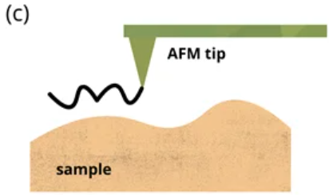
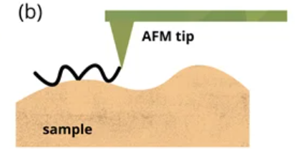
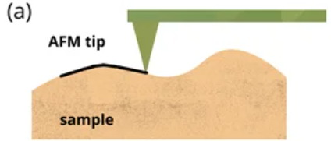
Working Mode
Contact mode
High-resolution
Sample can be damaged easily
Not good for soft material
Tapping mode
Less damage
Used to image the formation of molecules
Used for imaging in air
Non-contact mode
No damage
Advantageous for imaging soft samples
Notes:
AFM mainly operates in three modes: contact mode, tapping mode, and non-contact mode. Each mode represents a different way the tip interacts with the sample.
Contact Mode
In contact mode, the tip is in continuous contact with the surface.
This allows for high-resolution measurements, because the interaction is direct and stable.
However, the downside is that lateral forces can damage the sample, especially for soft materials like polymers or biological samples.
So this mode is mainly used for hard surfaces, such as metals or semiconductors.
Tapping Mode
In tapping mode, the cantilever oscillates and the tip intermittently touches the surface.
This significantly reduces lateral forces, so there is less damage to the sample.
Because of this, tapping mode is widely used to image soft materials and molecular structures.
It also works well in air, making it the most commonly used mode in practice.
Non-contact Mode
In non-contact mode, the tip does not touch the surface at all and only interacts through weak attractive forces.
This avoids damage completely and is advantageous for very delicate samples.
However, the signal is relatively weak and can be unstable, especially in ambient conditions, so the resolution is often lower.
So overall, contact mode provides high resolution but risks damage, non-contact mode avoids damage but has weaker signals, and tapping mode offers the best balance between resolution and sample safety.

Slide 5
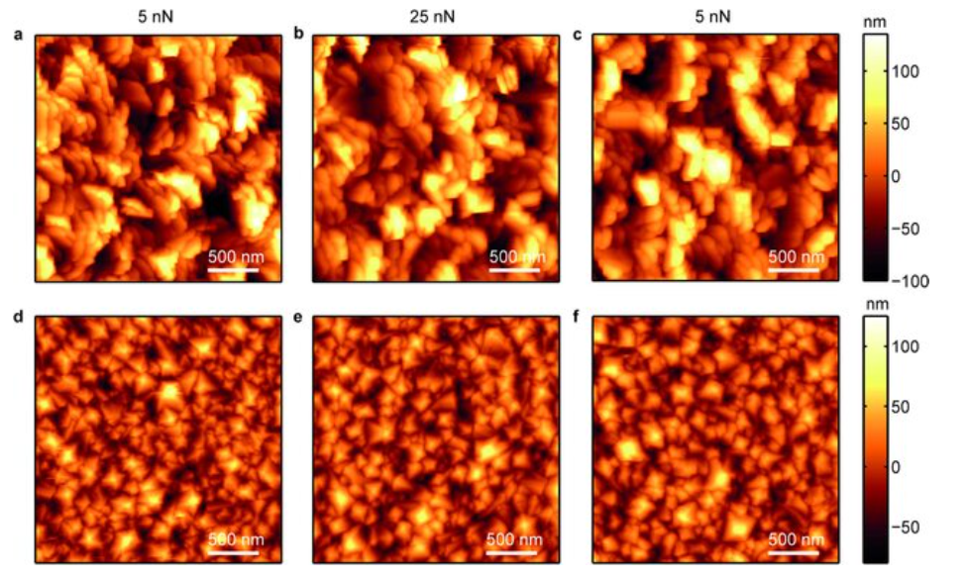
AFM Images
(a–c) Titanium surface. (d–f) UNCD surface
AFM images of polycrystalline surfaces under varying imaging forces (5nN, 25nN). Adapted from [1].
Notes:
ultra nanocrystal-line diamond (UNCD)
The “force” here refers to the tip–sample interaction force between the AFM tip and the surface, measured in nano-Newtons (nN).
AFM scans a microscale area but measures nanoscale features within that area

Slide 6
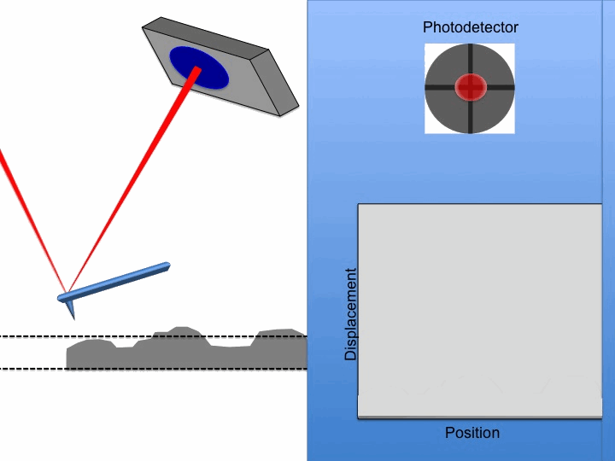
Limitations
Maximum height on the order of 10-20 um and a maximum scanning area of approximately 150 x 150 um
Scanning speed
Highly dependent on probes
Notes:
Despite its high resolution, AFM has several important limitations.”
Scan range / height
First, AFM has a limited scanning range.
The maximum scan area is typically around 150 by 150 micrometers, and the vertical range is about 10 to 20 micrometers.
This is because AFM relies on piezoelectric actuators, which provide very high precision but only over a small range.
So AFM is excellent for nanoscale detail, but not suitable for large-area imaging.
Scanning speed
Second, AFM is relatively slow.
It scans the surface point by point, unlike optical or electron microscopy which can capture images much faster.
This makes AFM less suitable for real-time imaging or large datasets.
Probe dependency
Third, AFM performance is highly dependent on the probe condition.
The tip can wear out over time and become rounded, which reduces resolution and distorts the measured surface.
So maintaining a sharp and clean tip is critical for accurate measurements.
Strong closing line
So overall, AFM involves a tradeoff: it provides extremely high resolution, but at the cost of limited scan size, slow speed, and sensitivity to probe condition.

Slide 7
Reference
[1] D. Vorselen, E. S. Kooreman, G. J. L. Wuite, and W. H. Roos,
“Controlled tip wear on high roughness surfaces yields gradual broadening and rounding of cantilever tips,” Beilstein Journal of Nanotechnology, vol. 8, pp. 265–273, 2017.
[2] I. Sivarajah, “Atomic Force Microscopy: General Principles and Applications,”
AZoOptics, Dec. 7, 2021. [Online].
Available: https://www.azooptics.com/Article.aspx?ArticleID=2083
[3] “Atomic Force Microscopy,” Tribonet, [Online].
Available: https://www.tribonet.org/wiki/atomic-force-microscopy/

Slide 8
Thank You

